Slide 1
AASD4011: Mathematical Concepts for Deep Learning
Multiclass Classification
Softmax
Sparse categorical cross-entropy
Wikipedia

Slide 2
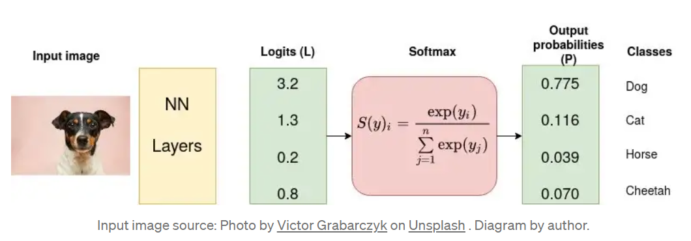
How Neural Network vote for class?
https://towardsdatascience.com/cross-entropy-loss-function-f38c4ec8643e

Slide 3
Logits
Logits are net inputs of last neuron layer.
They are un-normalize probabilities of the item belonging to a certain class.
Logits are often used in classification tasks, where the goal is to predict the class label of an input.

Slide 4
Activation Function:
Activation functions are functions used in a neural network to compute the weighted sum of inputs and biases, which is in turn used to decide whether a neuron can be activated or not.
It manipulates the presented data and produces an output for the neural network that contains the parameters in the data.
We have linear and non-linear activation function.
Some of activation functions are:
Logistic(Sigmoid)
Hyperbolic tang
Relu(Rectified Linear Unit)
Glue, Leaky Relu

Slide 5
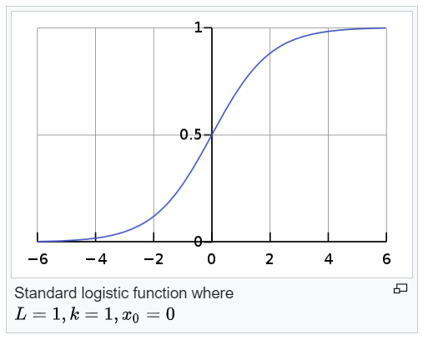

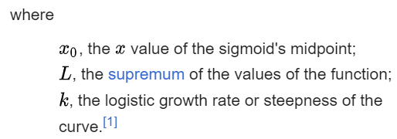
Logistic/Sigmoid Function
A logistic function is a common S-shaped curve (sigmoid curve) with equation:
The standard logistic function, where L=1,k=1,x_0=0, is sometimes simply called the sigmoid.
Wikipedia

Slide 6
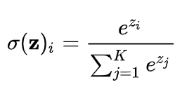
Softmax
A generalization of the Logistic Function
The softmax function takes as input a vector of K real numbers and normalizes it into a probability distribution consisting of K probabilities proportional to the exponentials of the input numbers. That is:
Prior to applying softmax, some vector components could be negative, or greater than one; and might not sum to 1; but after applying softmax, each component will be in the interval (0,1)
The components will add up to 1, so that they can be interpreted as probabilities
The larger input components will correspond to larger probabilities.

Slide 7
Softmax
https://towardsdatascience.com/cross-entropy-loss-function-f38c4ec8643e

Slide 8
Loss:
Cross-entropy loss, or log loss, measures the performance of a classification model whose output is a probability value between 0 and 1.
Cross-entropy loss increases as the predicted probability diverges from the actual label.

Slide 9
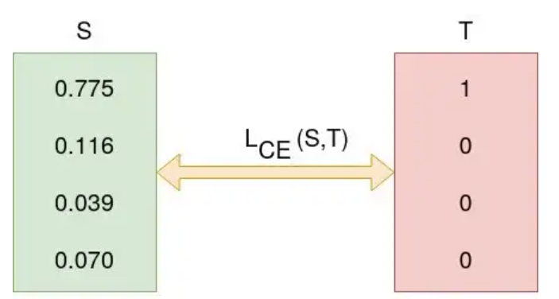
Categorical Cross-entropy
Computes the cross-entropy loss between the labels and predictions.
Cross-entropy is a quantity from the field of information theory that measures the distance between probability distributions or, in this case, between the ground-truth distribution and the model’s predictions.

Slide 10
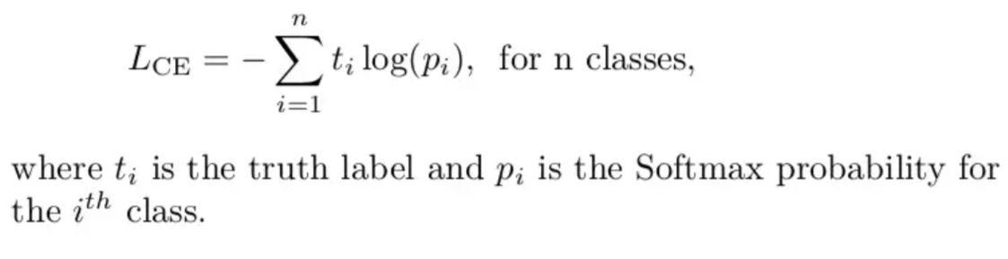
Categorical Cross-entropy

Slide 11
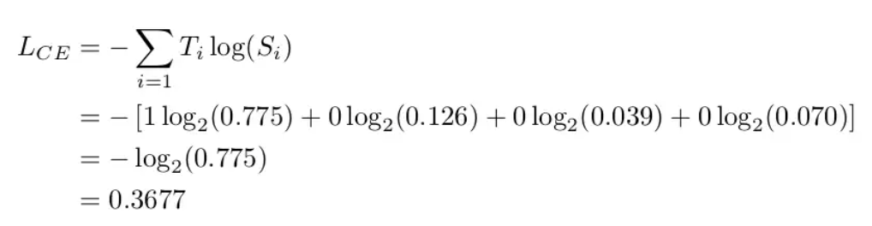
Categorical Cross-entropy

Slide 12
Sparse Categorical Cross-entropy
Categorical cross-entropy is used when true labels are one-hot encoded, for example, we have the following true values for 3-class classification problem [1,0,0], [0,1,0] and [0,0,1].
In sparse categorical cross-entropy , truth labels are integer encoded, for example, [1], [2] and [3] for 3-class problem.

